Slide 1



DEPARTMENT OF ELECTRICAL AND ELECTRONICS ENGINEERING
EEB1204 - ELECTRON DEVICES AND CIRCUITS
BATTERY CHARGER USING SCR AND 555 TIMER
YEAR/ SEMESTER – II/III
BATCH NUMBER : 1
DATE :05-12-2024
PRESENTED BY:
ISWARYA.P (927622BEE035)
KARNIKA.D (927623BEE039)
KARUNYA SHREE .S (927622BEE042)
KAVIYA.G (927622BEE043)
GUIDED BY:
Dr.S.Banumathi, M.E., Ph.D,
Professor /EEE

Slide 2
ABSTRACT
This project focuses on designing a battery charger circuit using a Silicon-Controlled Rectifier (SCR) and a 555 timer IC, which provides a controlled and efficient charging mechanism for batteries. The SCR acts as a switch to regulate the charging current supplied to the battery, while the 555 timer operates in astable mode to control the timing and switching of the SCR. The charger circuit is designed to prevent overcharging by automatically disconnecting the battery once it is fully charged. The 555 timer generates a periodic pulse signal, which triggers the SCR for precise control of the charging process. By adjusting the duty cycle of the timer, the charging current can be varied, providing flexibility for charging different types of batteries (e.g., lead-acid, lithium-ion).The integration of the SCR and 555 timer ensures that the battery is charged safely and efficiently, with the added benefit of minimizing power losses.

Slide 3
LITERATURE REVIEW
Patel et al.
ScienceDirect (2021)
In IEEE Access explored SCR-based chargers for lead-acid batteries, demonstrating high efficiency in current regulation and overcharging prevention. The paper highlights that SCRs significantly improve energy transfer by switching off when the battery reaches full charge. He analyzed the reliability of SCRs in high-current applications. They emphasized their robust performance but noted the need for precise triggering mechanisms, which can be achieved with a 555 timer.

Slide 4
IDENTIFICATION & DEFINITION OF PROBLEM
The primary problem in conventional battery charging systems is the lack of control over the charging process, leading to inefficiencies such as overcharging, overheating, and reduced battery lifespan.
These issues can significantly affect the performance and safety of the battery, especially in applications involving rechargeable batteries like lead-acid, lithium-ion, or nickel-cadmium types.
To address this, the proposed solution is to develop a battery charger circuit using a Silicon-Controlled Rectifier (SCR) and a 555 timer. The SCR will act as a switch to regulate the current flow, while the 555 timer will control the charging process by generating precise timing signals.

Slide 5
IDENTIFICATION OF ALTERNATE SOLUTIONS
Microcontroller-Based Charger:
Uses a microcontroller to monitor and control the charging process. It offers precise control and can handle different battery types, but is more complex and costly.
SMPS-Based Charger:
Highly efficient, lightweight, and compact charger that uses high-frequency switching. Ideal for fast charging but more complex and expensive to design.
CC-CV Charger (Constant Current-Constant Voltage):
Maintains a steady current and switches to steady voltage when needed, commonly used for lithium batteries. It's effective but requires careful monitoring.

Slide 6
PROJECT OBJECTIVES
The objective of this project is to design and create an affordable, efficient battery charger using an SCR and a 555 timer. This charger will solve common problems with traditional chargers, like overcharging, energy waste, and shorter battery life, by precisely controlling the charging process.
Control of Charging Current:
The SCR will act as a switch to manage the current flow, while the 555 timer will control when to turn the SCR on and off, ensuring the battery gets just the right amount of charge.
Prevention of Overcharging:
The charger will stop or reduce the current once the battery is full, preventing overcharging, which can damage the battery and reduce its lifespan.

Slide 7
PROJECT OBJECTIVES
Support for Different Battery Types:
The charger will work for various rechargeable batteries, like lead-acid, lithium-ion, and nickel-cadmium, with adjustable settings for different battery needs.
Cost-Effective Design:
By using simple components like SCRs and 555 timers, the charger will be low-cost but still reliable, making it a good option for different applications and energy efficiency.
Safety Features:
The charger will include protection mechanisms against issues like short circuits, overheating, and overvoltage, keeping both the battery and the charger safe during use.

Slide 8
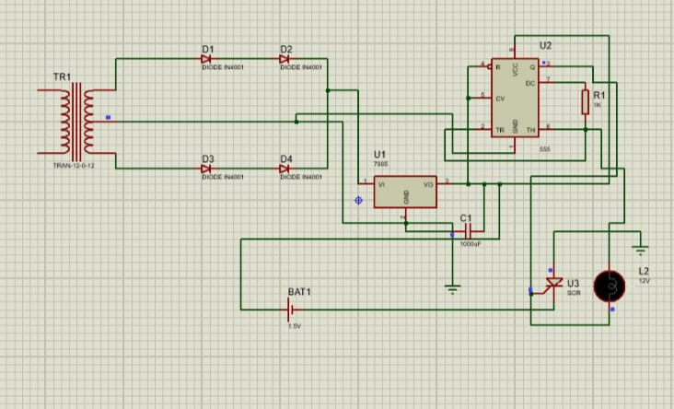
CIRCUIT DIAGRAM

Slide 9
COMPONENTS USED
555 Timer
Lamp
Diode(D1,D2,D3,D4) - IN4001
Resistor - 1k Ohm
Capacitor- 1000F
SCR

Slide 10
COMPONENTS USED
Transformer-12V
7805 IC
Bread board
Connecting wires
AC Source

Slide 11
COMPONENTS DESCRIPTION
555 Timer IC - The 555 can create time delays in circuits
Lamp - For indication of charging status
Diode - To prevent backflow
Resistor - Resist the current
Capacitor - Filter out high frequency AC noise from DC supply
SCR - Function as controlled rectifiers

Slide 12
COMPONENTS DESCRIPTION
AC source - Used for a variety of applications due to its ability to efficiently transmit electrical energy
Transformer - Step-down transformer (if using AC) or a suitable DC power supply
Bread board - For assembling the circuit
7805 IC – Regulates the voltage

Slide 13
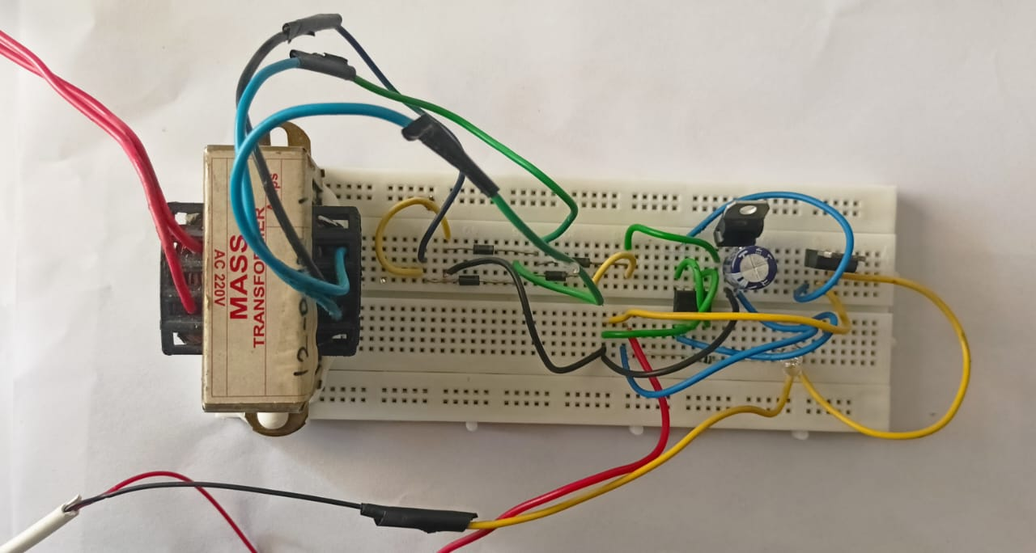
HARDWARE PHOTO

Slide 14
WORKING PROCESS
A battery charger using an SCR and a 555 timer works by regulating the charging current to the battery. First, the AC mains voltage is stepped down by a transformer and converted to DC using a rectifier circuit. The SCR acts as an electronic switch, controlling the current flow to the battery. It is triggered at its gate to allow current to pass when the battery needs charging.
The 555 timer monitors the battery's voltage level through a voltage divider. When the voltage is below a preset threshold, the 555 timer sends a signal to trigger the SCR, allowing charging to continue. As the battery charges and reaches the full voltage, the timer output changes, cutting off the SCR's gate signal, which stops the current flow to prevent overcharging.
This system ensures efficient and automatic charging, turning the charger on and off as needed. It is a simple and reliable design for maintaining battery health.

Slide 15
CONCLUSION
In conclusion, a battery charger using an SCR and a 555 timer provides an efficient and reliable way to control the charging process. The SCR regulates the current flow, while the 555 timer monitors the battery voltage to prevent overcharging. This setup ensures safe, automatic charging, extending the battery's lifespan and maintaining its performance.

Slide 16
FUTURE ENHANCEMENT
Microcontroller Integration: Replacing the 555 timer with a microcontroller to allow more precise voltage and current monitoring and the addition of advanced features like charging profiles for different battery types.
Overcurrent Protection: Incorporating additional circuits to protect against excessive current during faults or power surges.
Multiple Battery Compatibility: Modifying the design to support a variety of battery chemistries (e.g., Li-ion, NiMH) with selectable charging parameters.
5. Charging Status Indicators: Adding LED or digital displays to show real-time charging status, battery health, and remaining charge time.

Slide 17
REFERENCE
"Power Electronics: Circuits, Devices, and Applications" by Muhammad H. Rashid.
"Principles of Power Electronics" by John G. Kassakian et al.
" Basic Electronics for Scientists and Engineers" by Dennis L. Eggleston – Covers fundamentals of circuits including SCR and 555 timer.
"Electronic Devices and Circuit Theory" by Robert Boylestad and Louis Nashelsky – Discusses SCR operation and control.
"The Art of Electronics" by Paul Horowitz and Winfield Hill – Offers practical insights into timer circuits and power control.

